Slide 1
A200 Series Solar Panel Array
Notes:
This presentation was automatically generated by PowerPoint Copilot based on content found in this document: https://microsoft.sharepoint.com/teams/ContosoGreenEnergy/_layouts/15/Doc.aspx?sourcedoc=%7BF0F97EDA-69D5-4868-AD7B-219D90B36EAE%7D&file=Contoso%20A200%20Solar%20Panel%20Array.docx&action=default&mobileredirect=true&DefaultItemOpen=1 AI-generated content may be incorrect.

Slide 2
Agenda
Introduction
Solar Panel Specifications
Installation Guidelines
Maintenance Tips
Environmental Benefits
Cost Savings Over Time
MSRP Pricing and Discount Structure
Comparison of Panel Types
Diagrams for Clarity
Conclusion
Notes:
Agenda * Introduction * Solar Panel Specifications * Panel Types * Efficiency Metrics * Installation Guidelines * Site Assessment * Mounting the Panels * Electrical Connections * Maintenance Tips * Environmental Benefits * Cost Savings Over Time * MSRP Pricing and Discount Structure * Base Prices * Average Pricing for a 2600 Square Foot Home * Discounts and Incentives * Comparison of Panel Types * Diagrams for Clarity * Comparison of Panel Types * Solar Panel Installation * Conclusion

Slide 3
Introduction
Efficiency Metrics
Details on energy conversion rates
Comparison of different panel types
Installation Guidelines
Step-by-step installation process
Safety precautions
Maintenance Tips
Regular cleaning schedules
Inspection routines
Environmental Benefits
Potential Cost Savings
Comparison of Solar Panels
Notes:
This document outlines the specifications for a medium residential roof-mounted solar panel array, including efficiency, installation, maintenance, environmental benefits, and cost savings. It also compares monocrystalline and polycrystalline panels. Original Content: This document provides a detailed specification for a medium residential roof-mounted solar panel array. It covers efficiency metrics, installation guidelines, maintenance tips, environmental benefits, and potential cost savings over time. Additionally, it offers a comparison between monocrystalline and polycrystalline solar panels to help homeowners make an informed decision.

Slide 4
Solar Panel Specifications
Energy Conversion Efficiency
Monocrystalline panels: 15-20% efficiency
Polycrystalline panels: 13-16% efficiency
Temperature Coefficient
Monocrystalline panels perform better in high temperatures
Durability and Lifespan
Both types last 25-30 years
Monocrystalline panels often have longer warranties
Monocrystalline Solar Panels
Made from a single crystal structure
High efficiency and sleek appearance
Polycrystalline Solar Panels
Notes:
This slide covers the efficiency metrics of solar panels, including energy conversion efficiency, temperature coefficient, and durability. Monocrystalline panels are more efficient and perform better in high temperatures, while polycrystalline panels are less expensive but slightly less efficient. Original Content: Efficiency Metrics · Energy Conversion Efficiency: This indicates the percentage of sunlight that can be converted into usable electricity. Monocrystalline panels typically offer higher efficiency rates (15-20%) compared to polycrystalline panels (13-16%). · Temperature Coefficient: This metric measures how well the panel performs in high temperatures. Monocrystalline panels generally have a lower temperature coefficient, making them more efficient in hot climates. · Durability and Lifespan: Both panel types are built to last, with a typical lifespan of 25-30 years. However, monocrystalline panels often come with a longer warranty period. · Monocrystalline Solar Panels: Made from a single crystal structure, these panels are known for their high efficiency and sleek appearance. They typically have an efficiency rate of 15-20%. · Polycrystalline Solar Panels: Composed of multiple silicon crystals, these panels are generally less expensive but also slightly less efficient, with an efficiency rate of 13-16%.

Slide 5
Panel Types
Monocrystalline Solar Panels
Made from a single crystal structure
High efficiency and sleek appearance
Efficiency rate of 15-20%
Polycrystalline Solar Panels
Composed of multiple silicon crystals
Generally less expensive
Efficiency rate of 13-16%
Notes:
Monocrystalline solar panels are made from a single crystal structure, offering high efficiency of 15-20%. Polycrystalline panels, composed of multiple silicon crystals, are less expensive but have a lower efficiency of 13-16%. Original Content: · Monocrystalline Solar Panels: Made from a single crystal structure, these panels are known for their high efficiency and sleek appearance. They typically have an efficiency rate of 15-20%. · Polycrystalline Solar Panels: Composed of multiple silicon crystals, these panels are generally less expensive but also slightly less efficient, with an efficiency rate of 13-16%.

Slide 6
Efficiency Metrics
Energy Conversion Efficiency
Monocrystalline panels: 15-20%
Polycrystalline panels: 13-16%
Temperature Coefficient
Monocrystalline panels perform better in high temperatures
Lower temperature coefficient for monocrystalline panels
Durability and Lifespan
Both types last 25-30 years
Monocrystalline panels often have longer warranties
Notes:
Monocrystalline panels offer higher efficiency (15-20%) compared to polycrystalline (13-16%). They also perform better in high temperatures and often come with longer warranties, though both types last 25-30 years. Original Content: · Energy Conversion Efficiency: This indicates the percentage of sunlight that can be converted into usable electricity. Monocrystalline panels typically offer higher efficiency rates (15-20%) compared to polycrystalline panels (13-16%). · Temperature Coefficient: This metric measures how well the panel performs in high temperatures. Monocrystalline panels generally have a lower temperature coefficient, making them more efficient in hot climates. · Durability and Lifespan: Both panel types are built to last, with a typical lifespan of 25-30 years. However, monocrystalline panels often come with a longer warranty period.

Slide 7
Installation Guidelines
Roof Structure Analysis
Ensure roof can support solar panel weight
Evaluate roof's orientation and tilt angle
Identify potential shading issues
Mounting the Panels
Use a sturdy mounting system
Install panels at optimal tilt angle (30-45 degrees)
Ensure proper spacing between panels
Electrical Connections
Hire a certified electrician
Install an inverter for DC to AC conversion
Consider a battery storage system
Notes:
To install solar panels, analyze your roof structure, evaluate orientation and shading, and use a sturdy mounting system. Ensure proper electrical connections by hiring a certified electrician and installing an inverter and battery storage system. Original Content: · Conduct a thorough analysis of your roof structure to ensure it can support the additional weight of the solar panels. · Evaluate the roof's orientation and tilt angle to maximize sunlight exposure. · Identify any potential shading issues from nearby trees or buildings. Mounting the Panels · Use a sturdy mounting system that can withstand local weather conditions, including high winds and heavy snow loads. · Install the panels at an optimal tilt angle (typically between 30-45 degrees) to maximize solar exposure. · Ensure proper spacing between panels to allow for thermal expansion and adequate ventilation. Electrical Connections · Hire a certified electrician to handle the electrical connections to ensure safety and compliance with local codes. · Install an inverter to convert the DC electricity generated by the panels into AC electricity for home use. · Consider installing a battery storage system for energy storage and use during non-sunny periods.

Slide 8
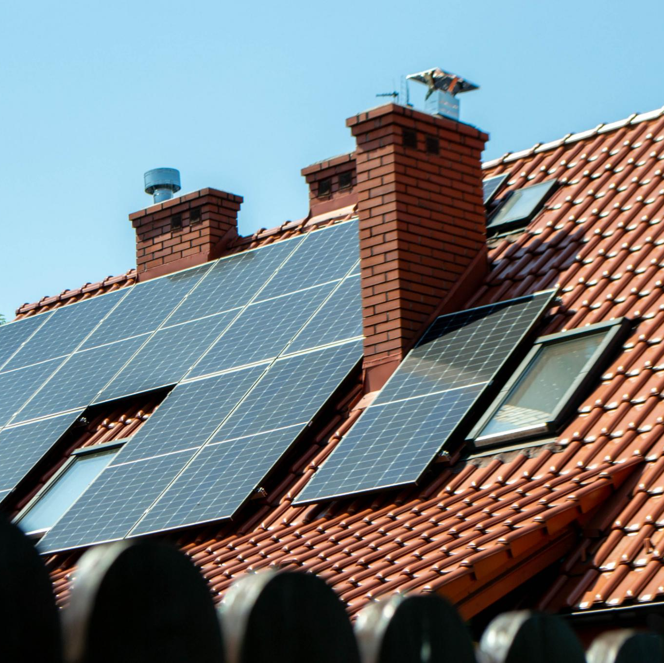
Site Assessment
Analyze Roof Structure
Ensure it can support the additional weight of solar panels
Evaluate Roof Orientation and Tilt
Maximize sunlight exposure
Identify Shading Issues
Check for shading from nearby trees or buildings
Notes:
Conduct a thorough analysis of your roof structure, evaluate its orientation and tilt, and identify any potential shading issues to ensure optimal solar panel installation. Original Content: · Conduct a thorough analysis of your roof structure to ensure it can support the additional weight of the solar panels. · Evaluate the roof's orientation and tilt angle to maximize sunlight exposure. · Identify any potential shading issues from nearby trees or buildings.

Slide 9
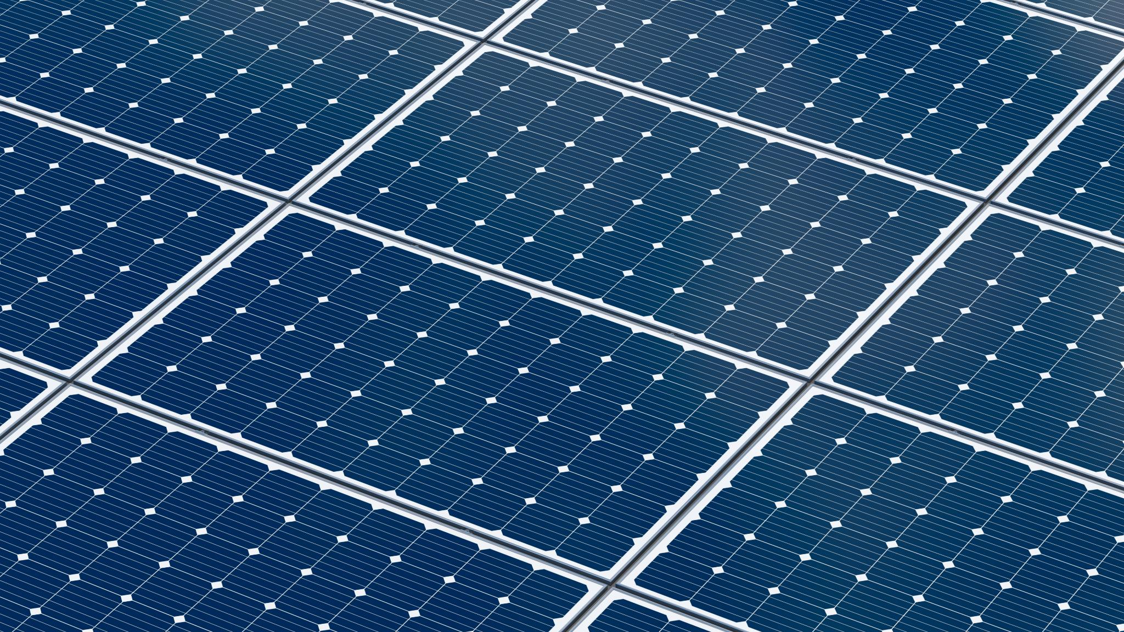
Mounting the Panels
Sturdy Mounting System
Withstand local weather conditions
High winds and heavy snow loads
Optimal Tilt Angle
Typically between 30-45 degrees
Maximize solar exposure
Proper Spacing Between Panels
Allow for thermal expansion
Ensure adequate ventilation
Notes:
Ensure a sturdy mounting system for solar panels to withstand weather, install at a 30-45 degree tilt for maximum exposure, and maintain proper spacing for thermal expansion and ventilation. Original Content: · Use a sturdy mounting system that can withstand local weather conditions, including high winds and heavy snow loads. · Install the panels at an optimal tilt angle (typically between 30-45 degrees) to maximize solar exposure. · Ensure proper spacing between panels to allow for thermal expansion and adequate ventilation.

Slide 10
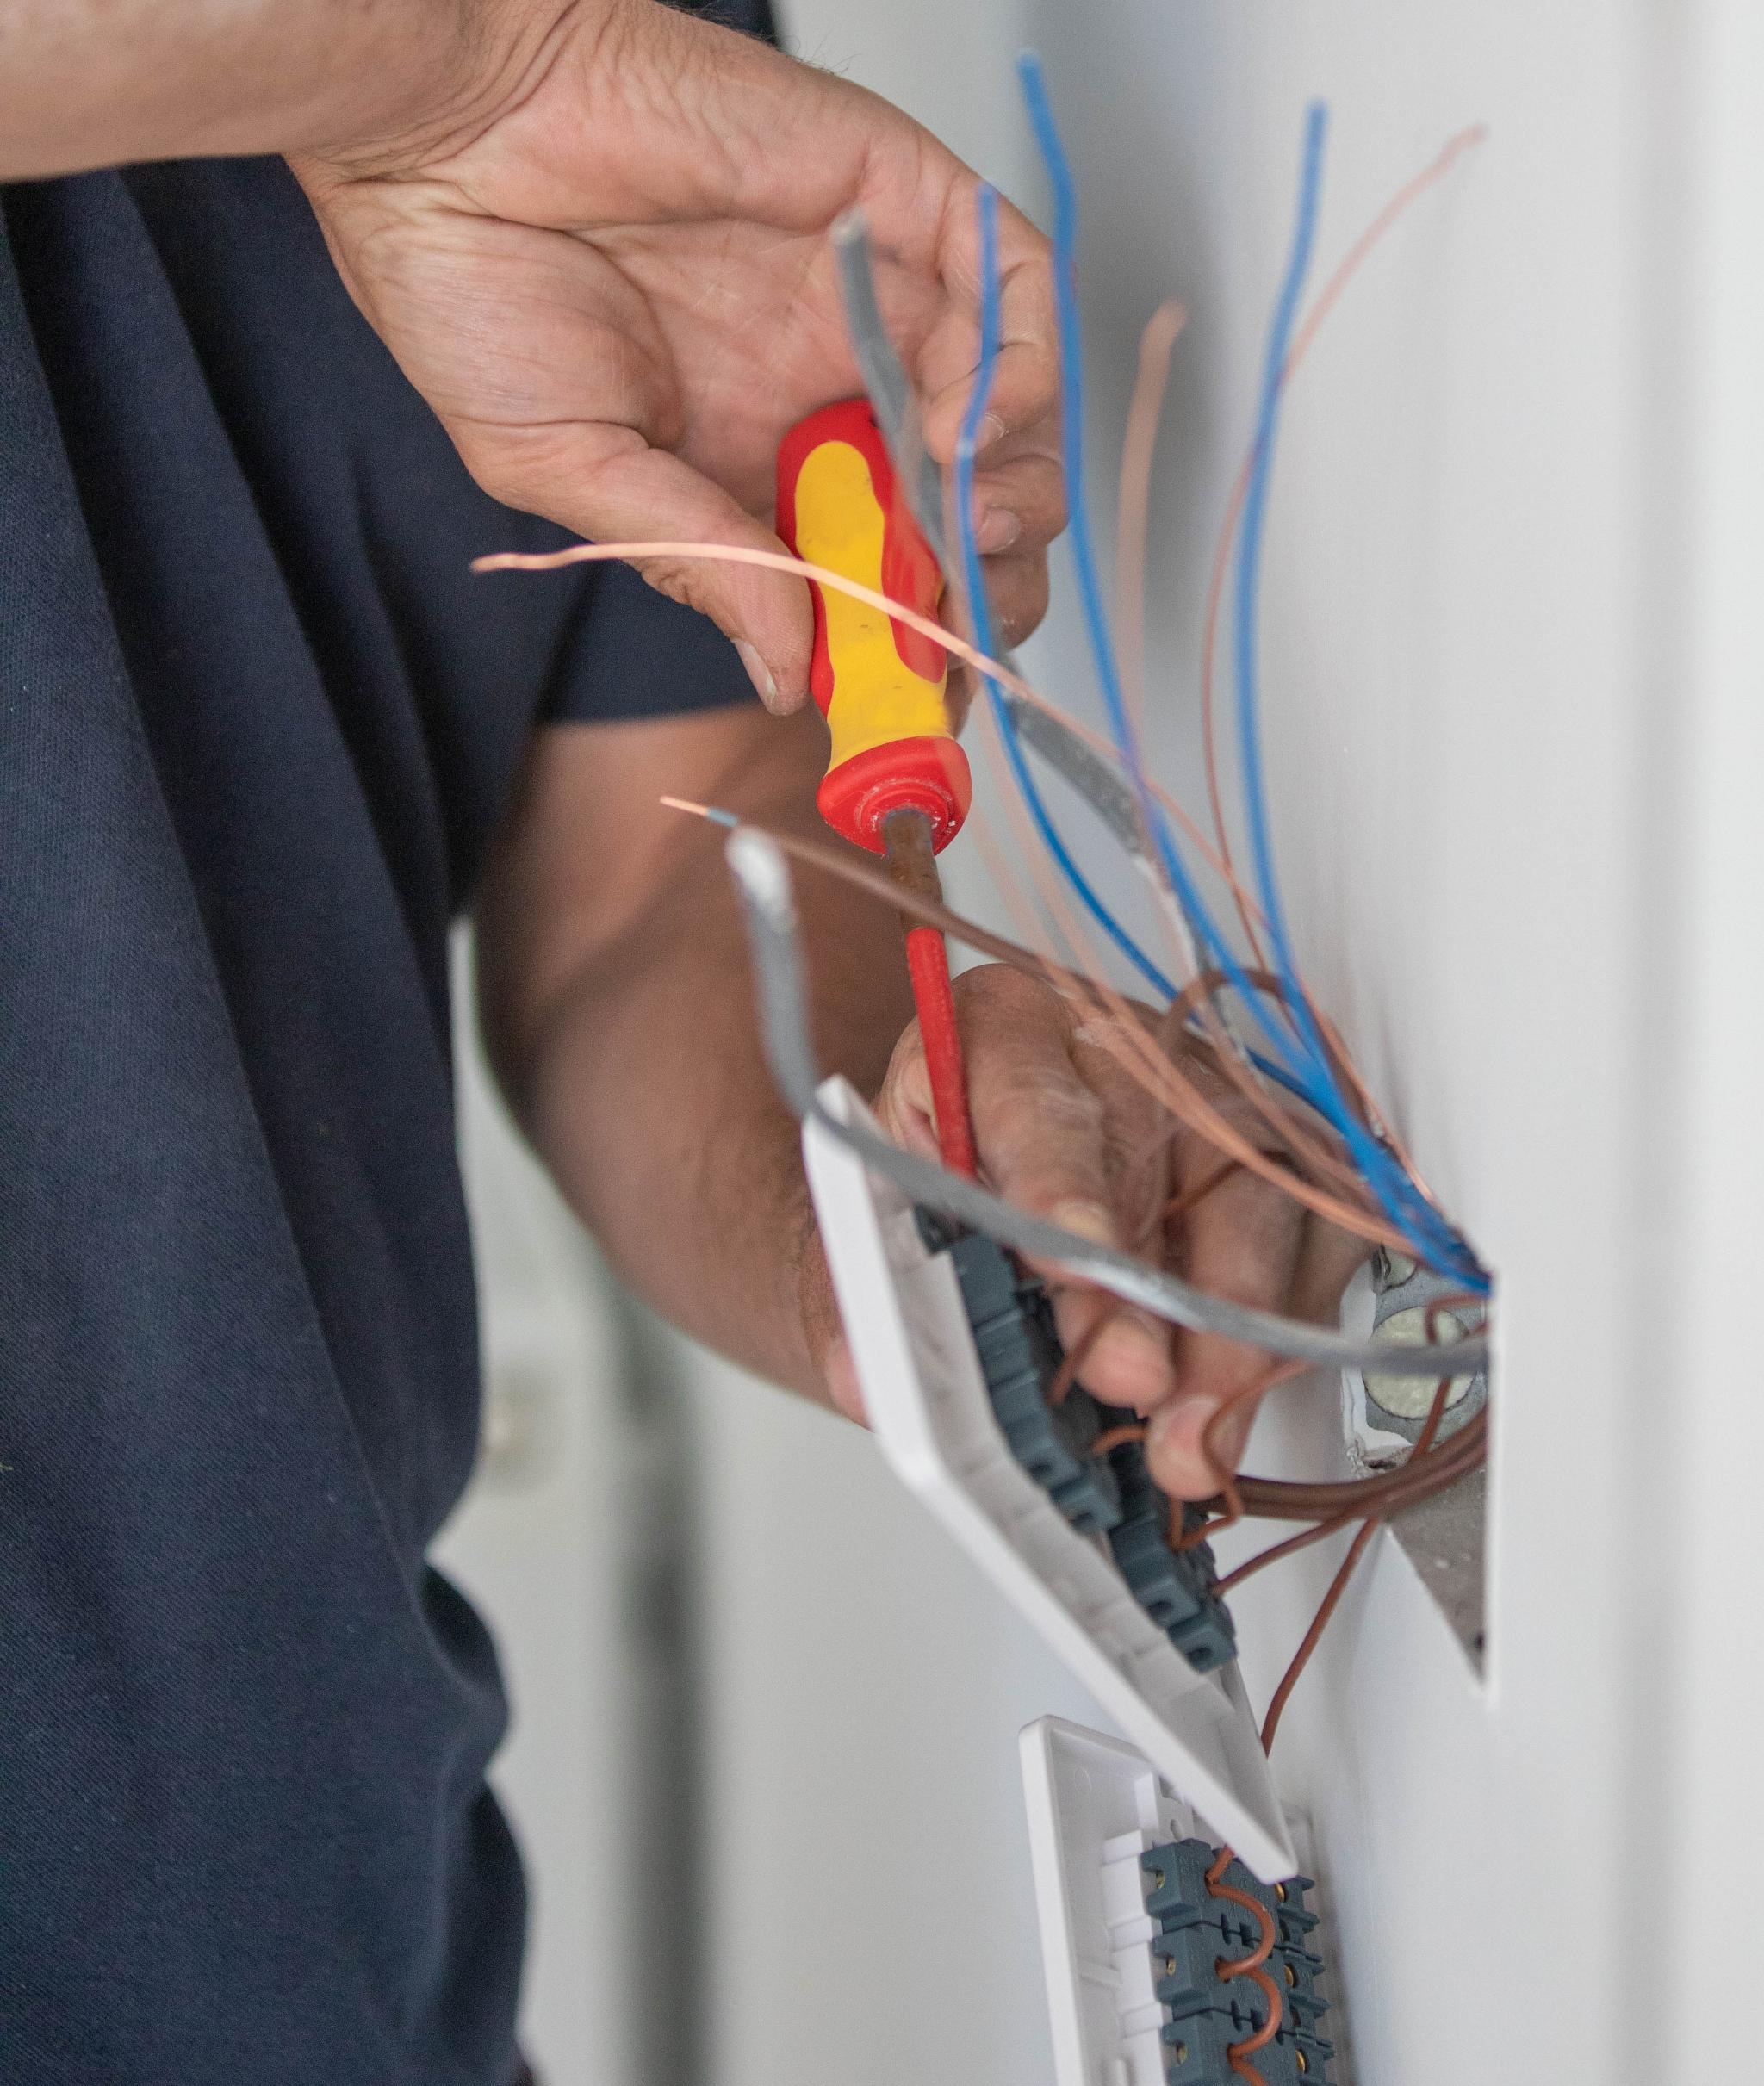
Electrical Connections
Hire a Certified Electrician
Ensure safety and compliance with local codes
Install an Inverter
Convert DC electricity to AC electricity for home use
Consider Battery Storage System
Store energy for use during non-sunny periods
Notes:
To install solar panels, hire a certified electrician for safety and code compliance. Install an inverter to convert DC to AC electricity. Consider a battery storage system for energy use during non-sunny periods. Original Content: · Hire a certified electrician to handle the electrical connections to ensure safety and compliance with local codes. · Install an inverter to convert the DC electricity generated by the panels into AC electricity for home use. · Consider installing a battery storage system for energy storage and use during non-sunny periods.

Slide 11
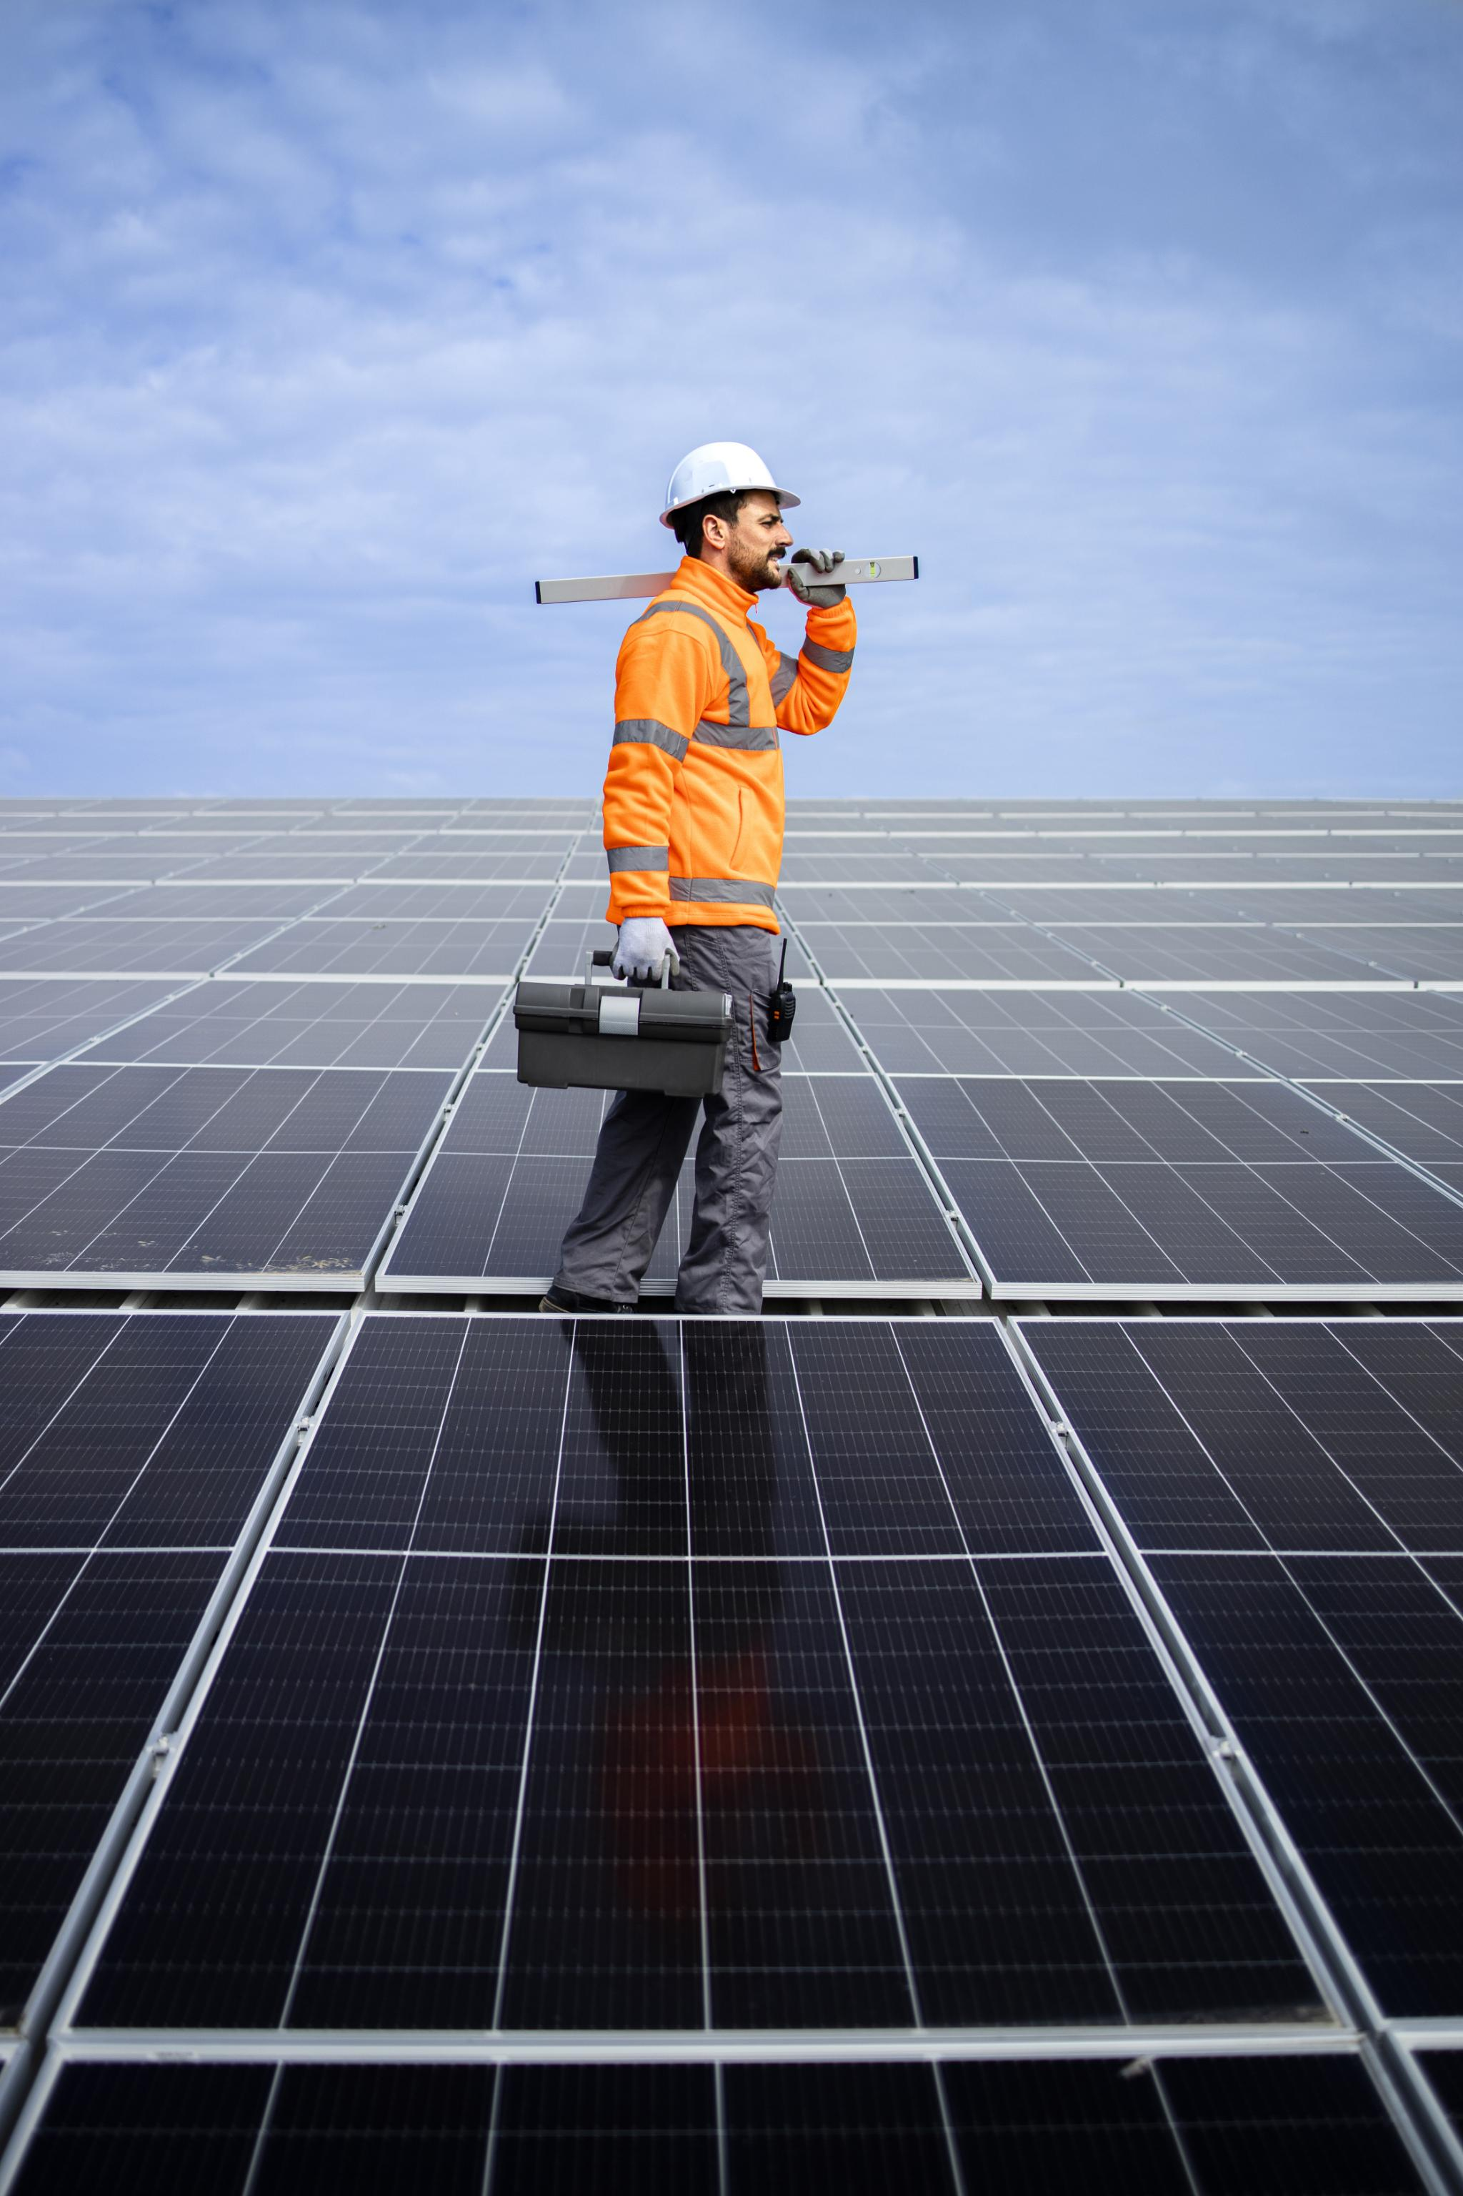
Maintenance Tips
Regular Cleaning
Remove dirt, dust, and debris to maintain efficiency
Inspection of Panels and Mounting System
Look for signs of damage or wear, especially after severe weather
Electrical Connections and Inverter Check
Ensure they are functioning correctly
Professional Inspections and Maintenance
Schedule at least once a year for optimal performance
Notes:
To maintain solar panel efficiency, regularly clean them to remove dirt and debris. Inspect for damage, especially after severe weather. Check electrical connections and the inverter periodically. Schedule professional inspections and maintenance annually. Original Content: · Regularly clean the panels to remove dirt, dust, and debris that can reduce efficiency. · Inspect the panels and mounting system for any signs of damage or wear, especially after severe weather events. · Check the electrical connections and inverter periodically to ensure they are functioning correctly. · Schedule professional inspections and maintenance at least once a year to ensure optimal performance.

Slide 12
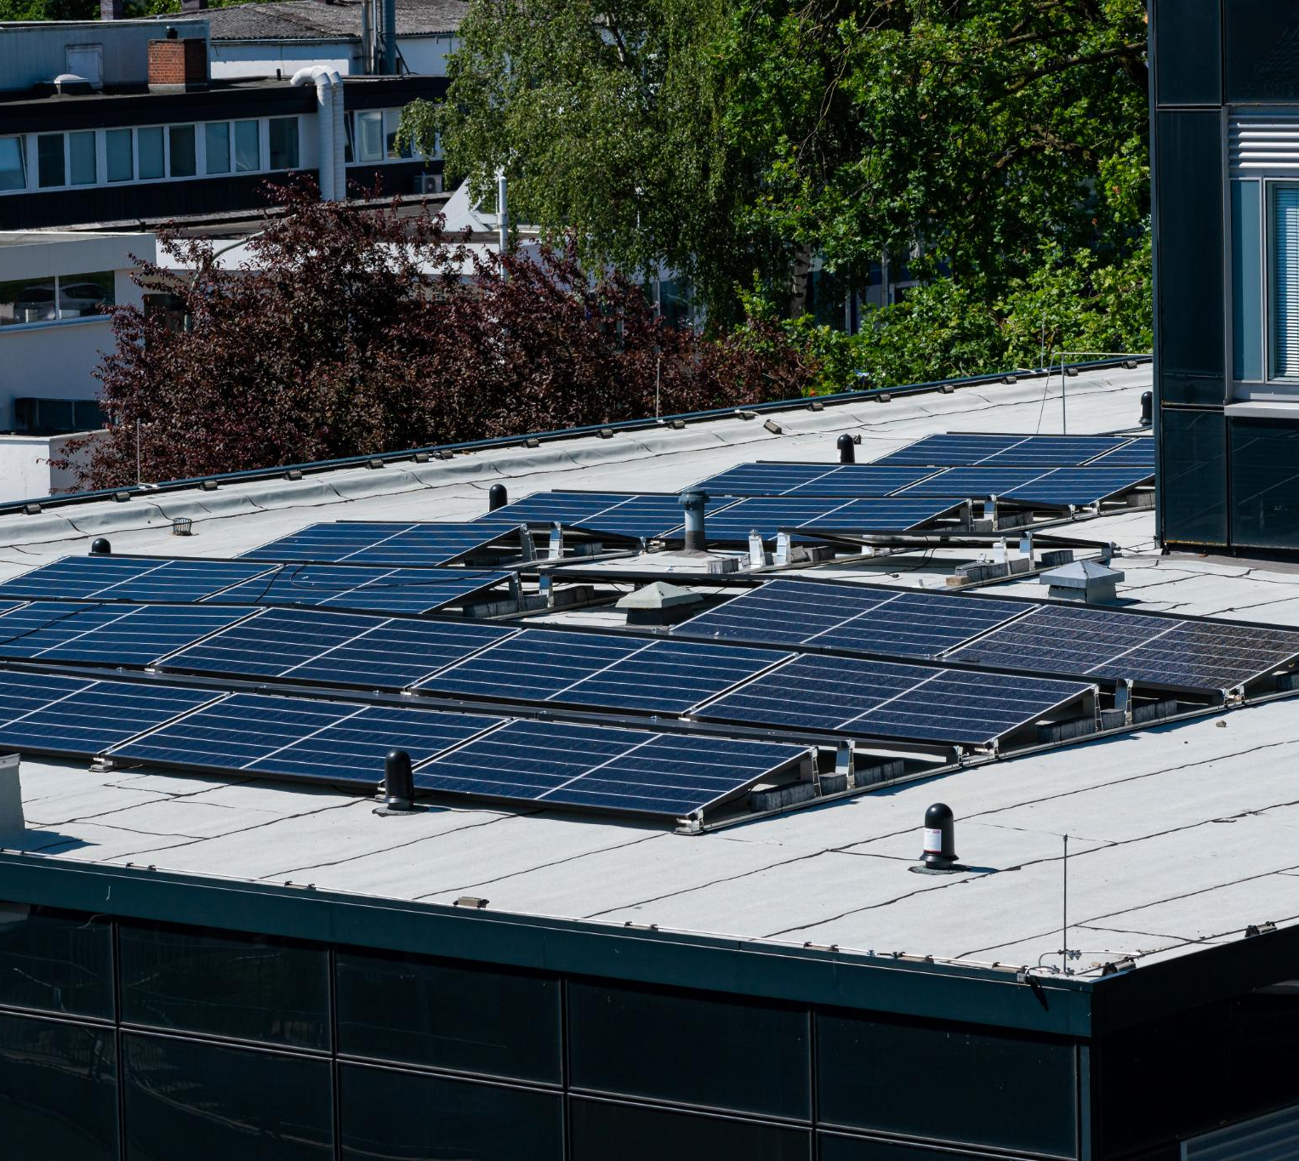
Environmental Benefits
Reduction in Carbon Footprint
Solar panels produce clean, renewable energy
Reduces reliance on fossil fuels
Lowers greenhouse gas emissions
Energy Independence
Generate your own electricity
Reduce dependence on the grid
Contribute to energy security
Sustainable Investment
Abundant resource
Can be harnessed without depleting natural resources
Environmentally friendly
Notes:
Solar energy offers numerous benefits including reducing carbon footprint, promoting energy independence, and being a sustainable investment. Solar panels produce clean energy, reduce reliance on fossil fuels, and lower greenhouse gas emissions. Generating your own electricity enhances energy security. Solar energy is abundant and environmentally friendly. Original Content: · Reduction in Carbon Footprint: Solar panels produce clean, renewable energy, reducing reliance on fossil fuels and lowering greenhouse gas emissions. · Energy Independence: By generating your own electricity, you reduce dependence on the grid and contribute to energy security. · Sustainable Investment: Solar energy is an abundant resource that can be harnessed without depleting natural resources or harming the environment.

Slide 13
Cost Savings Over Time
Initial Investment
Upfront cost can be significant
Incentives and tax credits available to reduce financial burden
Energy Bill Savings
Can significantly reduce or eliminate monthly electricity bills
Leads to substantial savings over time
Return on Investment
Most homeowners see ROI within 5-10 years
Continued savings for the lifespan of the system
Increased Home Value
Can increase your home's market value
Makes home more attractive to potential buyers
Notes:
Installing solar panels offers several benefits. The initial investment can be offset by incentives and tax credits. Solar panels reduce energy bills, provide a return on investment within 5-10 years, and increase home value, making it more attractive to buyers. Original Content: · Initial Investment: While the upfront cost of solar panels can be significant, various incentives and tax credits are available to reduce the financial burden. · Energy Bill Savings: Solar panels can significantly reduce or even eliminate your monthly electricity bills, leading to substantial savings over time. · Return on Investment: Most homeowners see a return on investment within 5-10 years, with continued savings for the lifespan of the system. · Increased Home Value: Installing solar panels can increase your home's market value, making it more attractive to potential buyers.

Slide 14
MSRP Pricing and Discount Structure
Monocrystalline Panels
Cost: $0.80 to $1.50 per watt
Average cost for 2600 sq ft home: $20,800 to $39,000 (26 kW system)
Polycrystalline Panels
Cost: $0.60 to $1.00 per watt
Average cost for 2600 sq ft home: $15,600 to $26,000 (26 kW system)
Discounts and Incentives
Bulk Purchase Discounts: Save up to 10% on orders exceeding 10 kW
Seasonal Promotions: Special discounts during peak installation seasons
Federal and State Tax Credits: Up to 26% tax credit available
Referral Programs: Earn discounts for referring new customers
Financing Options: Low-interest financing available through selected partners
Notes:
Monocrystalline panels cost between $0.80 and $1.50 per watt, while polycrystalline panels range from $0.60 to $1.00 per watt. For a 2600 sq ft home, monocrystalline panels cost $20,800 to $39,000, and polycrystalline panels cost $15,600 to $26,000. Discounts include bulk purchase, seasonal promotions, tax credits, referral programs, and financing options. Original Content: · Monocrystalline Panels: $0.80 to $1.50 per watt · Polycrystalline Panels: $0.60 to $1.00 per watt Average Pricing for a 2600 Square Foot Home: · Monocrystalline Panels: Approximately $20,800 to $39,000 (assuming 26 kW system) · Polycrystalline Panels: Approximately $15,600 to $26,000 (assuming 26 kW system) Discounts and Incentives: · Bulk Purchase Discounts: Save up to 10% on orders exceeding 10 kW · Seasonal Promotions: Special discounts available during peak installation seasons · Federal and State Tax Credits: Up to 26% tax credit available through federal incentives, with additional state-specific rebates · Referral Programs: Earn discounts for referring new customers · Financing Options: Low-interest financing available through selected partners

Slide 15
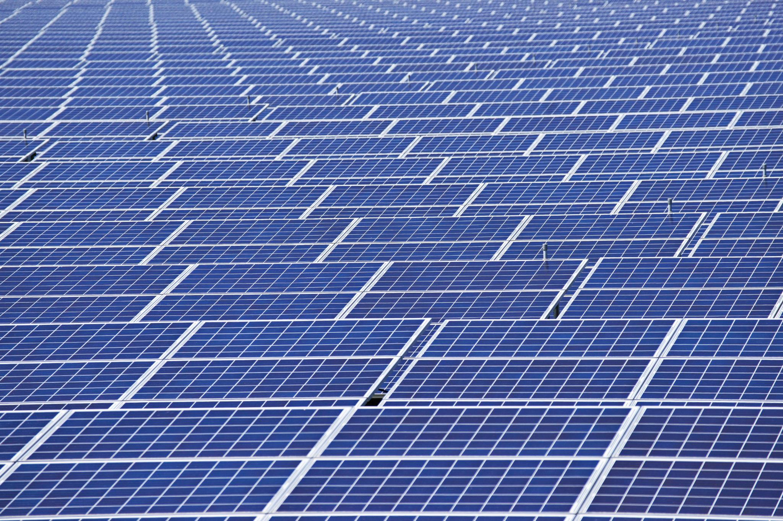
Base Prices
Monocrystalline Panels
Cost ranges from $0.80 to $1.50 per watt
Polycrystalline Panels
Cost ranges from $0.60 to $1.00 per watt
Notes:
Monocrystalline panels cost between $0.80 and $1.50 per watt, while polycrystalline panels range from $0.60 to $1.00 per watt. Original Content: · Monocrystalline Panels: $0.80 to $1.50 per watt · Polycrystalline Panels: $0.60 to $1.00 per watt

Slide 16
Average Pricing for a 2600 Square Foot Home
Monocrystalline Panels
Cost ranges from $20,800 to $39,000
Assumes a 26 kW system
Polycrystalline Panels
Cost ranges from $15,600 to $26,000
Assumes a 26 kW system
Notes:
Monocrystalline panels cost between $20,800 and $39,000 for a 26 kW system, while polycrystalline panels range from $15,600 to $26,000 for the same system. Original Content: · Monocrystalline Panels: Approximately $20,800 to $39,000 (assuming 26 kW system) · Polycrystalline Panels: Approximately $15,600 to $26,000 (assuming 26 kW system)

Slide 17
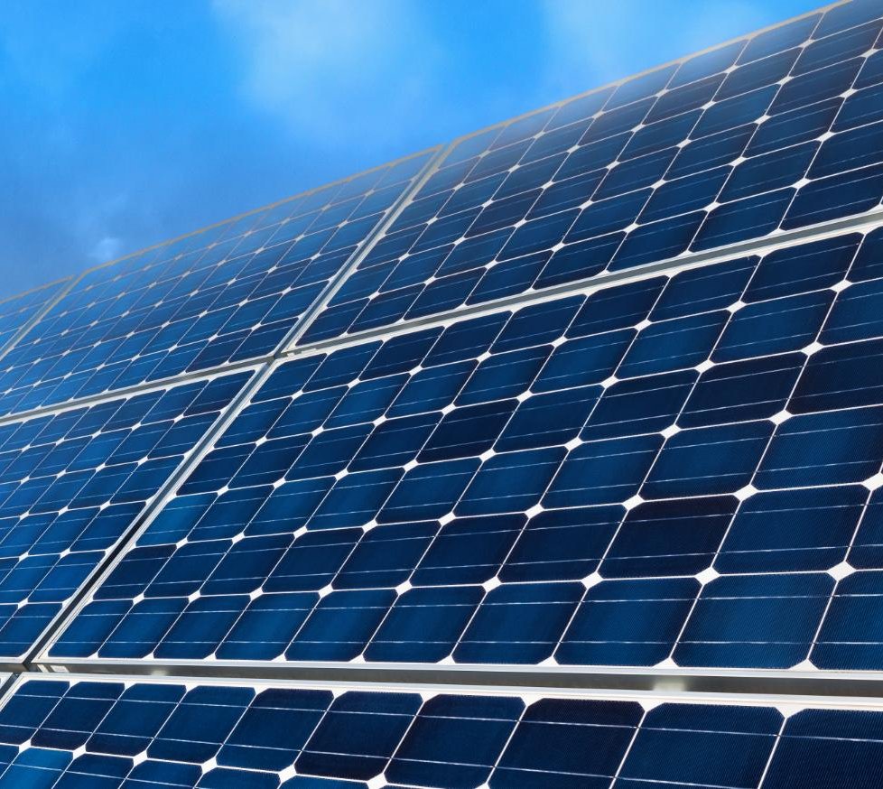
Discounts and Incentives
Bulk Purchase Discounts
Save up to 10% on orders exceeding 10 kW
Seasonal Promotions
Special discounts available during peak installation seasons
Federal and State Tax Credits
Up to 26% tax credit available through federal incentives
Additional state-specific rebates
Referral Programs
Earn discounts for referring new customers
Financing Options
Low-interest financing available through selected partners
Notes:
Discover various discounts and incentives for solar installations, including bulk purchase discounts, seasonal promotions, federal and state tax credits, referral programs, and low-interest financing options. Original Content: · Bulk Purchase Discounts: Save up to 10% on orders exceeding 10 kW · Seasonal Promotions: Special discounts available during peak installation seasons · Federal and State Tax Credits: Up to 26% tax credit available through federal incentives, with additional state-specific rebates · Referral Programs: Earn discounts for referring new customers · Financing Options: Low-interest financing available through selected partners

Slide 18
Comparison of Panel Types
Efficiency
Monocrystalline panels: 15-20%
Polycrystalline panels: 13-16%
Cost
Polycrystalline panels are generally less expensive
Appearance
Monocrystalline panels: uniform black color
Polycrystalline panels: blueish hue with speckled appearance
Space Requirements
Monocrystalline panels require less space due to higher efficiency
Longevity
Both types have similar lifespans
Notes:
Monocrystalline panels are more efficient and space-saving but cost more. They have a uniform black color. Polycrystalline panels are cheaper with a blueish hue. Both have similar lifespans, but monocrystalline often have longer warranties. Original Content: · Efficiency: Monocrystalline panels are more efficient (15-20%) compared to polycrystalline panels (13-16%). · Cost: Polycrystalline panels are generally less expensive due to their simpler manufacturing process. · Appearance: Monocrystalline panels have a uniform black color, while polycrystalline panels have a blueish hue with a speckled appearance. · Space Requirements: Due to their higher efficiency, monocrystalline panels require less space to generate the same amount of electricity as polycrystalline panels. · Longevity: Both types have similar lifespans, but monocrystalline panels often come with longer warranties.

Slide 19
Diagrams for Clarity
Step | Description | Component
1 | Site Assessment | Solar Engineer
2 | Design and Planning | Design Software
3 | Permitting | Permit Documents
4 | Mount Installation | Mounting Hardware
5 | Panel Installation | Solar Panels
6 | Electrical Wiring | Wiring & Conduits
7 | Connecting Inverter | Inverter
8 | Battery Setup (if applicable) | Battery Storage
9 | System Testing | Testing Tools
10 | Activation | Monitoring System
Electrical Connections
Steps for electrical connection setup
Includes inverter and battery storage system
Comparison of Panel Types
Monocrystalline vs Polycrystalline solar panels
Notes:
This slide covers the steps for setting up electrical connections for residential solar panels, including the inverter and battery storage. It also compares monocrystalline and polycrystalline solar panels. Original Content: · The steps and components involved in installing a residential roof-mounted solar panel array. Electrical Connections: · Steps for electrical connection setup, including the inverter and battery storage system. Comparison of Panel Types: · Table comparing the key differences between monocrystalline and polycrystalline solar panels.

Slide 20
Comparison of Panel Types
Feature | Monocrystalline Solar Panels | Polycrystalline Solar Panels
Material | Single crystal silicon | Multiple silicon crystals
Efficiency | 15-20% | 13-16%
Appearance | Sleek, uniform black | Bluer, speckled
Cost | Higher | Lower
Space Efficiency | More efficient, requires less space | Less efficient, requires more space
Longevity | Generally longer lifespan | Slightly shorter lifespan
Notes:
This slide compares monocrystalline and polycrystalline solar panels in terms of efficiency, cost, appearance, space efficiency, and lifespan. Original Content: · Table comparing the key differences between monocrystalline and polycrystalline solar panels.

Slide 21
Solar Panel Installation
Step | Description | Component
1 | Site Assessment | Solar Engineer
2 | Design and Planning | Design Software
3 | Permitting | Permit Documents
4 | Mount Installation | Mounting Hardware
5 | Panel Installation | Solar Panels
6 | Electrical Wiring | Wiring & Conduits
7 | Connecting Inverter | Inverter
8 | Battery Setup (if applicable) | Battery Storage
9 | System Testing | Testing Tools
10 | Activation | Monitoring System
Steps for Installing Solar Panels
Assess the roof's condition and suitability
Design the solar panel layout
Install mounting system
Attach solar panels to the mounting system
Electrical Connection Setup
Install the inverter
Connect the solar panels to the inverter
Set up the battery storage system
Connect the system to the home’s electrical panel
Notes:
This slide covers the steps and components involved in installing a residential roof-mounted solar panel array. It includes the installation process and the setup of the electrical connection, including the inverter and battery storage system. Original Content: · The steps and components involved in installing a residential roof-mounted solar panel array. · Steps for electrical connection setup, including the inverter and battery storage system.

Slide 22
Conclusion
Environmental Benefits
Reduces carbon footprint
Promotes sustainable living
Energy Independence
Decreases reliance on grid power
Ensures a stable energy supply
Cost Savings
Lowers energy bills
Potential for government incentives
Efficiency Metrics
Installation Guidelines
Maintenance Tips
Notes:
Investing in residential roof-mounted solar panels offers environmental benefits, energy independence, and cost savings. Understand efficiency metrics, follow installation guidelines, and maintain your system to maximize benefits. Original Content: Investing in a medium residential roof-mounted solar panel array is a smart choice for environmentally-conscious homeowners looking to reduce their carbon footprint, achieve energy independence, and save on energy costs. By understanding the efficiency metrics, installation guidelines, and maintenance tips outlined in this document, you can make an informed decision and maximize the benefits of your solar investment.

